Slide 1

PROJECT PRESENTATION
Customer Shopping Behavior Analysis
Insights into spending patterns, customer segments, and strategic opportunities.

Slide 2



Project Overview
Objective
This project analyzes transactional data to uncover insights into spending patterns, customer segments, product preferences, and subscription behavior.
Dataset Scope
The analysis is based on a robust dataset comprising 3,900 purchases across various product categories, enabling data-driven strategic business decisions.

Slide 3
Dataset Summary
3.9K
18
37
TOTAL ROWS
FEATURES
MISSING RATINGS
Key features include Demographics (Age, Gender, Location) and Purchase Details (Item, Amount, Season).

Slide 4



Methodology & Tech Stack
Python
PostgreSQL
Power BI
Data Cleaning & Feature Engineering
Structured Business Transactions Analysis
Interactive Dashboard Development
Missing values in Review Ratings were imputed using median category ratings.

Slide 5
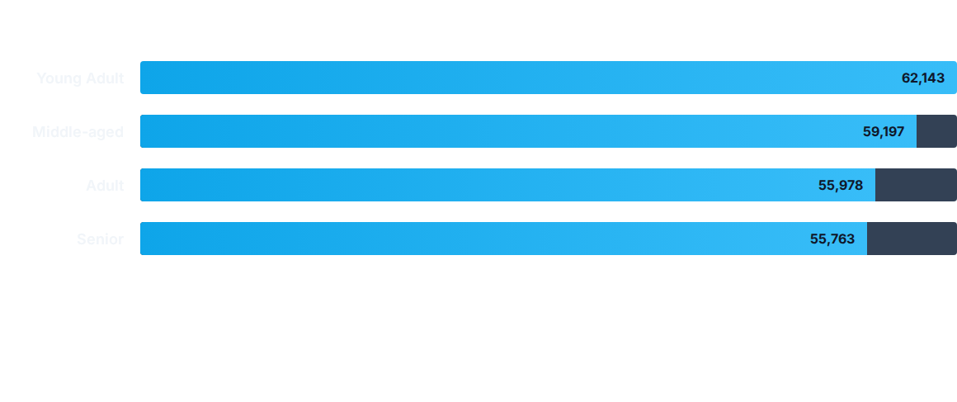
Revenue by Age Group
Key Insight: Young Adults are the highest revenue contributors, suggesting a need for targeted marketing strategies for this demographic.

Slide 6
Top Performing Products
Category | Top Product | Total Orders | Avg Rating
Accessories | Jewelry | 171 | 3.75
Clothing | Blouse | 171 | 3.80
Footwear | Sandals | 160 | 3.84
Outerwear | Jacket | 163 | 3.70
Items like Gloves, Sandals, and Boots consistently receive the highest review ratings across all categories.

Slide 7
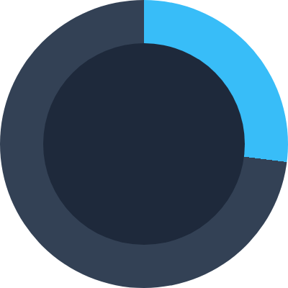
Subscription Status Analysis
•
Subscribers (27%)
•
Non-Subscribers (73%)
While subscribers account for only 27% of the customer base, repeat buyers (5+ purchases) are significantly more likely to subscribe.

Slide 8






Customer Segmentation
Loyal
Returning
New
3,116 Customers
701 Customers
83 Customers
The core of our revenue, demonstrating high retention.
Customers with potential to convert to the loyal segment.
Recent acquisitions requiring engagement strategies.

Slide 9


Operational Insights
Shipping Impact
Review Consistency
Express Shipping users spend slightly more ($60.48) on average compared to Standard Shipping users ($58.46).
The average review rating is stable at 3.75.
Top rated items include Gloves (3.86) and Sandals (3.84), indicating high satisfaction with accessories and footwear.
This suggests an opportunity to bundle express shipping with higher-value tiers.

Slide 10

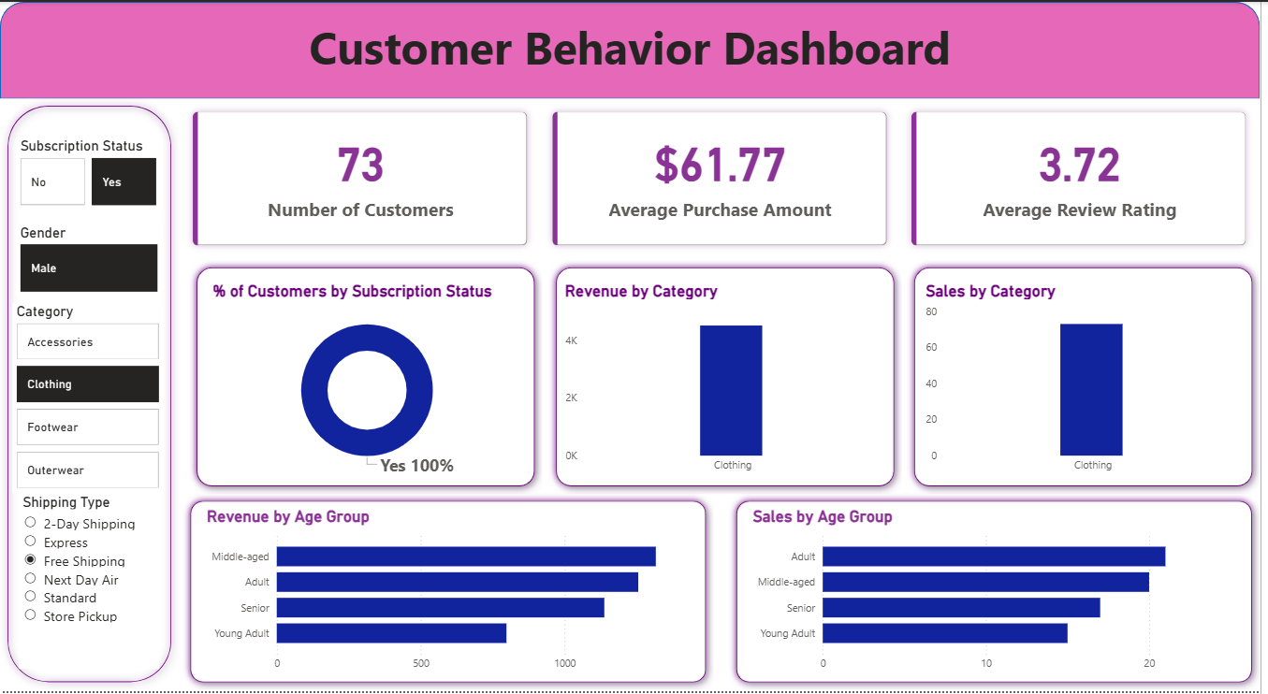
Power BI Dashboard
Interactive visualization of demographics, revenue, and trends.

Slide 11

Strategic Recommendations
Boost Subscriptions: Promote exclusive benefits to convert the 73% non-subscriber base.
Loyalty Programs: Reward repeat buyers to solidify the "Loyal" segment and reduce churn.
Targeted Marketing: Focus ad spend on high-revenue "Young Adult" and "Middle-Aged" demographics.
Product Positioning: Highlight top-rated products (e.g., Sandals, Gloves) in seasonal campaigns.

Slide 12
Thank You

